Slide 1
Ship Detection
Zifan Wang
Bowen Jia
Haoxuan Jia
Yicun Hou
Sprint 2
Trello: https://trello.com/b/Oqa6fBy5/ship-detection
Github: https://github.com/ethanhou99/Ship-Detection

Slide 2
Current Accomplishments
Read codes from Kaggle Kernels, follow instructions and try to build our own training procedures.
Researched the basic theory of CNN, R-CNN from papers and GitHub
Set up the environment for object detection,
e.g. Tensorflow GPU on Ubuntu System, CUDA and etc.
Modified codes on the Kaggle and got elementary results
Specified basic functions of user’s interface

Slide 3

Why NOT Yolo V3
Resolution is relatively low, like 768 * 768 pixels, which means object can be small on pixel scale, which is YOLO’s shortcut to detect small objects.
“You only look once (YOLO) is a real-time object detection system. On a Pascal Titan X it processes images at 30 FPS and has a mAP of 57.9% on COCO test-dev.”
Yolo mainly focus on object recognition in video sequences, which does not apply to our project.
Datasets are pics shot by satellite, which means there’s only 2 dimensions to consider about. Models for 3D object segmentation is overqualified

Slide 4

System Diagram
*
Initialize parameters for the learning framework
Input a picture
Apply pre-processing steps
to remove noises
(will be remove if it doesn’t work)
Input a picture from training set
Use learning model to predict the location of the ship
Output the trained model
Process on the picture
Renew
Parameters
Fine-tuning on the picture
e.g. draw the contours of ships for better users’ interface
Figure out deviation
No
Below threshold?
Yes
Output the result
Training: U-net
Software

Slide 5
Training: Basic Models
to find if there’s a ship in the picture
This part is a process we use to get familiar with basic training functions and compare different models to find whether they’re suitable for the task
The code runs on the cloud service offered by kaggle, which is of high efficiency but have a time limit when using it
We chose Densenet, Xception, Inception and Resnet to acquaint the whole progesss

Slide 6
Training: Basic Models
to find if there’s a ship in the picture
Hyper Parameters:
batch_size 64
learning rate 0.0001
epoch 30
Pics are resized from 768*768 to 300*300
( for faster computing)
 | Densenet 169 | Densenet 121 | Xception | Inceptionv3 | Resnet 52
Loss | 0.7339 | 1.3342 | 1.4774 | 1.4821 | 2.4814
Accuracy | 0.65 | 0.5938 | 0.6484 | 0.6016 | 0.5859
val_loss | 0.4483 | 0.5869 | 0.9982 | 0.5587 | 0.5996
val_acc | 0.8260 | 0.7130 | 0.6230 | 0.7520 | 0.7990
time(min) | 13.4 | 8.7 | 20 | 14 | 12

Slide 7
Training: U-Net
Method found in Kaggle’s Kernel
U-Net is a convolutional network specifically designed for Biomedical Image Segmentation and suits satellite images segmentation(https://spark-in.me/)
U-Net’s architecture was modified and extended to work with fewer training images and to yield more precise segmentations(high- efficiency).
Kick out pictures that don’t have ship in to reduce processing time
Augment dataset for more precise model construction

Slide 8
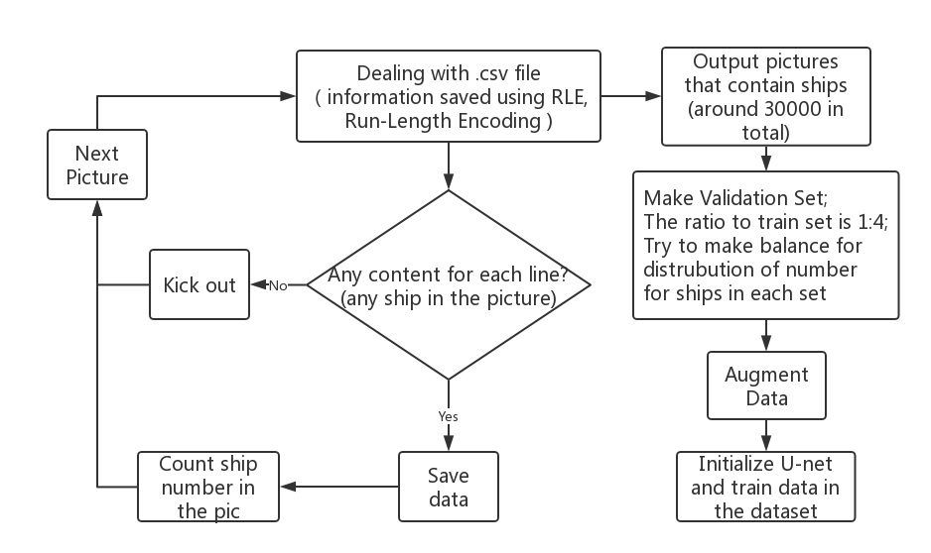
Training: Pre-Training Diagram
*
To speed up the pre-training progress, we reduced the official training set by following procedure
Training set reduced from
88k to 35k

Slide 9
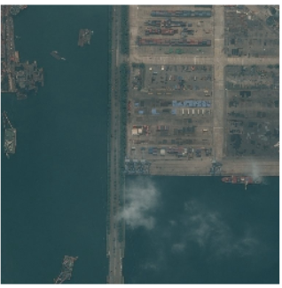
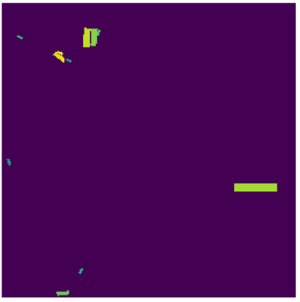
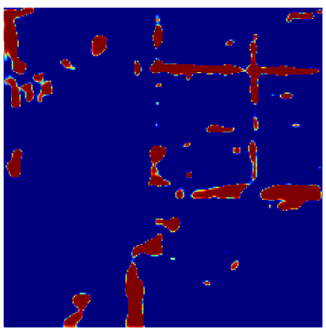
Training: Unet Results
*
Test environment
CPU: Intel i7-8750H
Memory: 16G DDR4 2667MHz
GPU: GTX1070
28k train set & 7k validation set
Hyper Parameters
batch_size = 48
epoch = 60
steps per epoch = 9
no resizing of input pics
5 Hrs for (CPU) and 57 Mins for (GPU)
Input Image
Data Visualization from .csv file
Predicted result from trained model

Slide 10
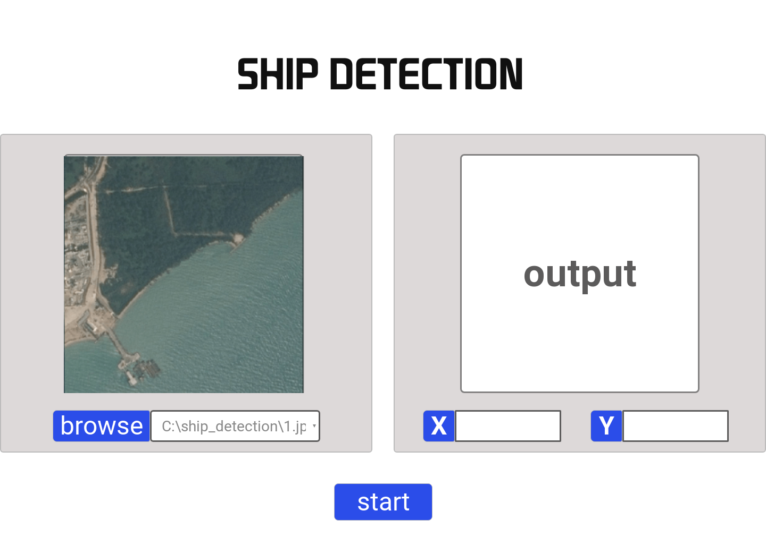
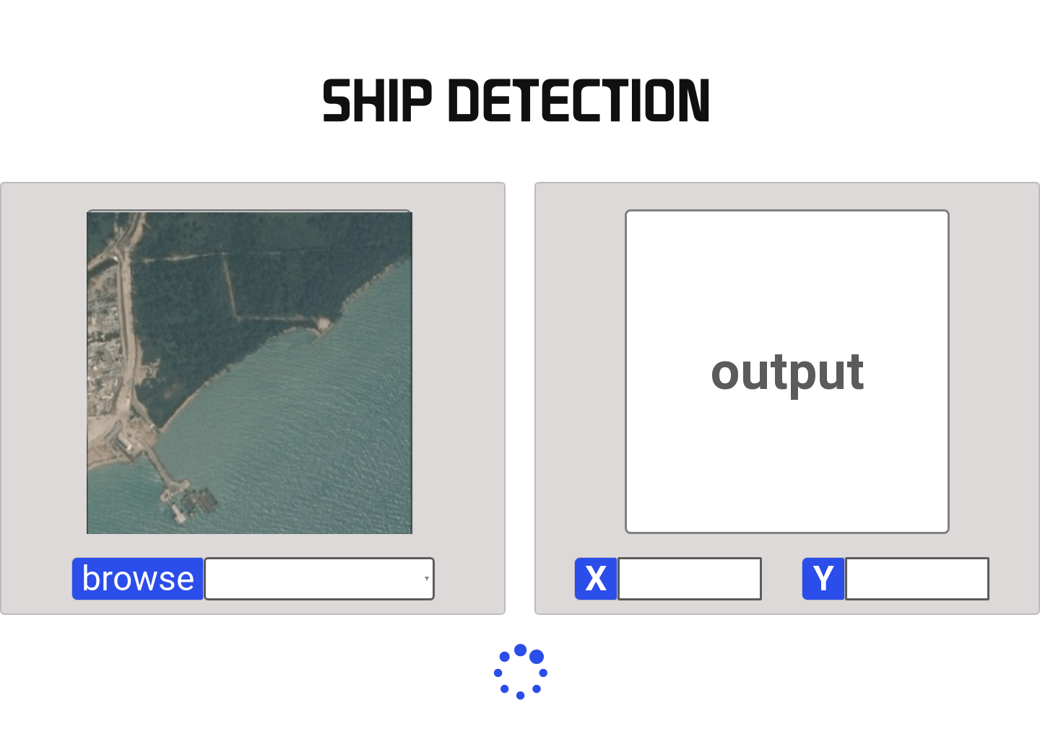
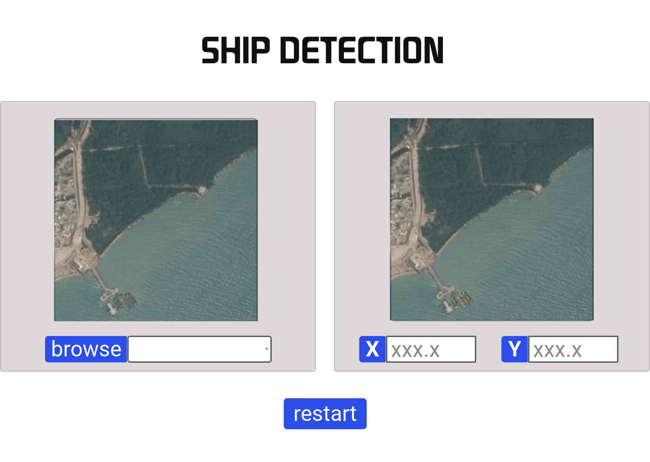
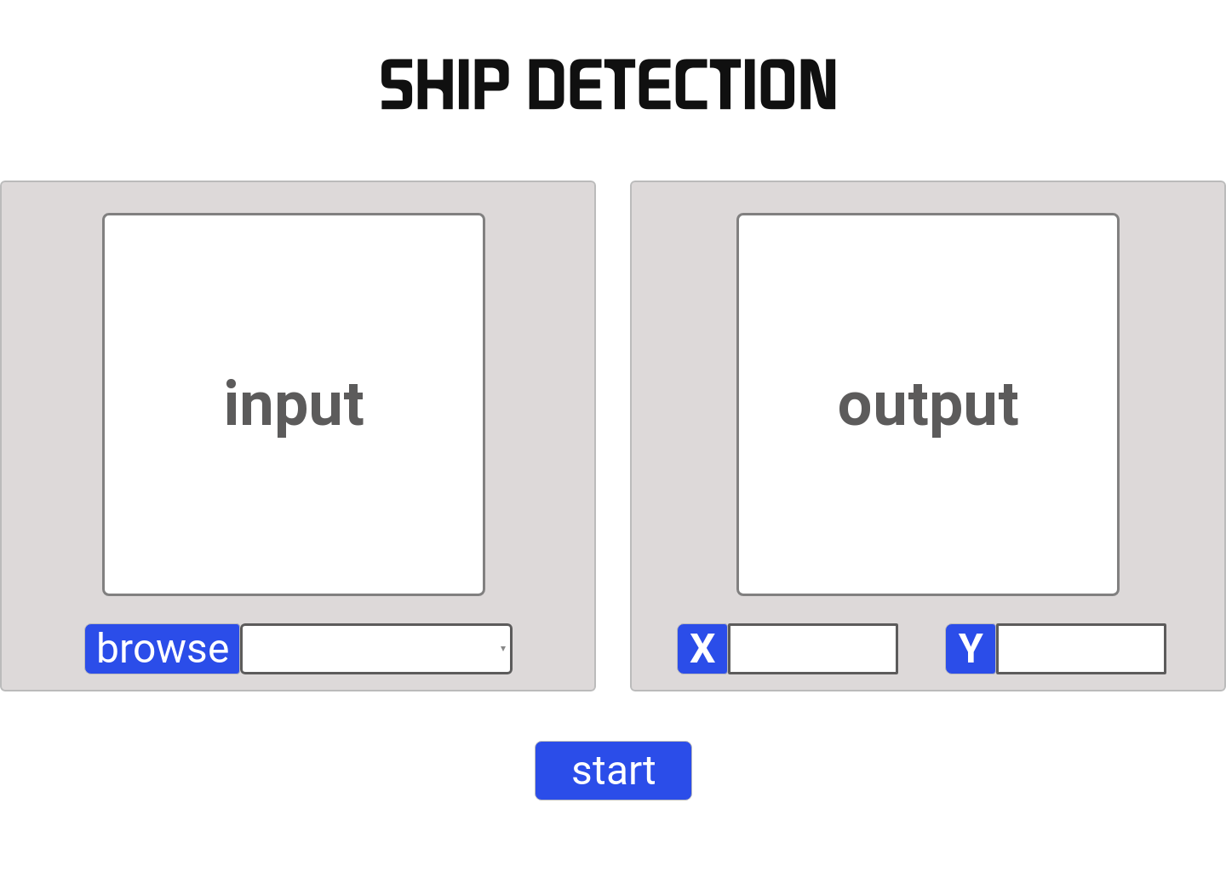
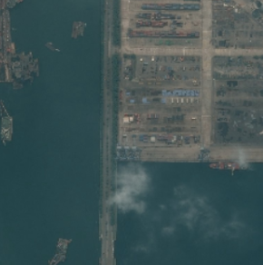
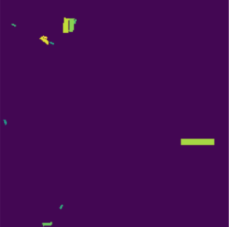
Basic UI Design

Slide 11
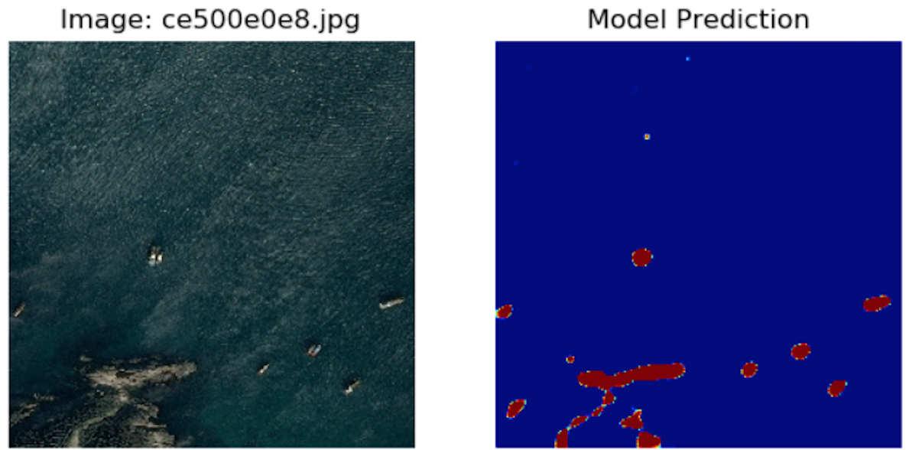
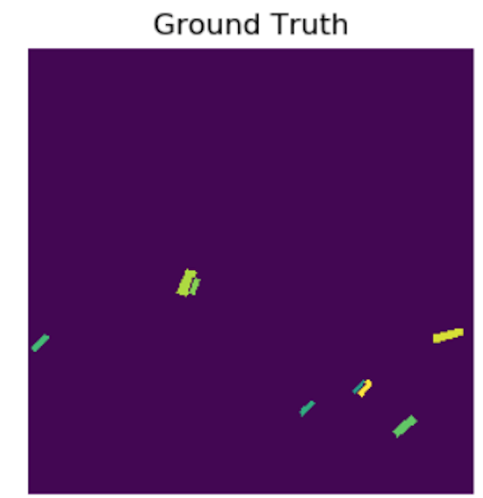
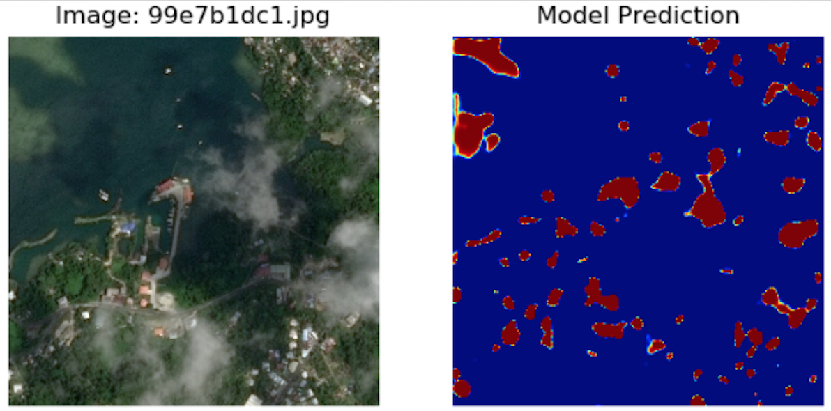
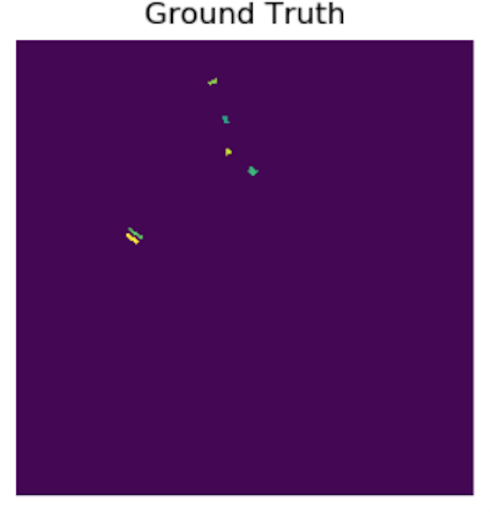
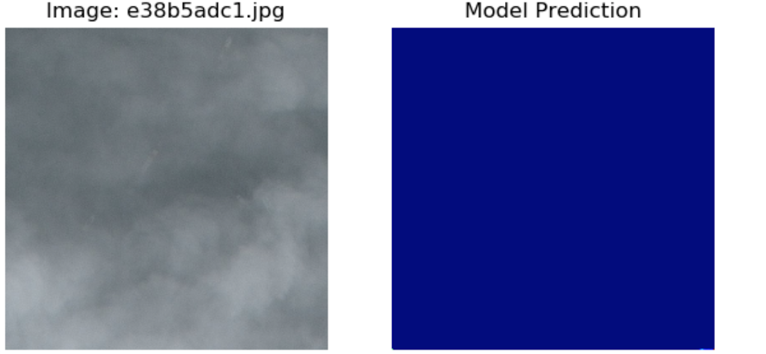
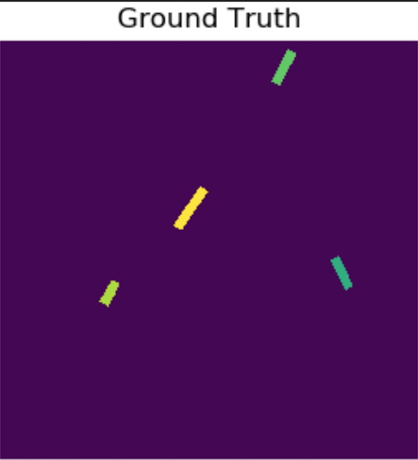
Challenges
*
Deal with noises like:
Clouds, Landscape, Houses, Waves
……

Slide 12
Challenges
*
Tiny ships on the picture (could be only a few pixels)
How to implement the model into software
How to train the model on SCC(we met storage problems)

Slide 13
Next Sprint Plan
*
Implement the model into software
Train the project using SCC
Understand and try to make improvements to U-net model
Train the whole dataset instead of excluding pictures that don’t contain ships
Find ways to improve the training efficiency

Slide 14
Reference
https://zhuanlan.zhihu.com/p/26377387
https://www.kaggle.com/hmendonca/u-net-model-with-submission
https://developers.planet.com/tutorials/detect-ships-in-planet-data/
https://www.kaggle.com/hmendonca/u-net-model-with-submission
https://www.kaggle.com/kmader/baseline-u-net-model-part-1

Slide 15
Thank You !
Zifan Wang chesterw@bu.edu
Bowen Jia jeff0410@bu.edu
Haoxuan Jia hxjia@bu.edu
Yicun Hou yicunhou@bu.edu

